Slide 3
Repentance

Slide 4
“Or those eighteen on whom the tower in Siloam fell and killed them: do you think that they were worse offenders than all the others who lived in Jerusalem?
No, I tell you; but unless you repent, you will all likewise perish.”
- Luke 13:2-3

Slide 5
Repentance is required for our salvation.

Slide 6
Actions That Prove Repentance
Disposed to Change
Sorrow For Sin

Slide 7
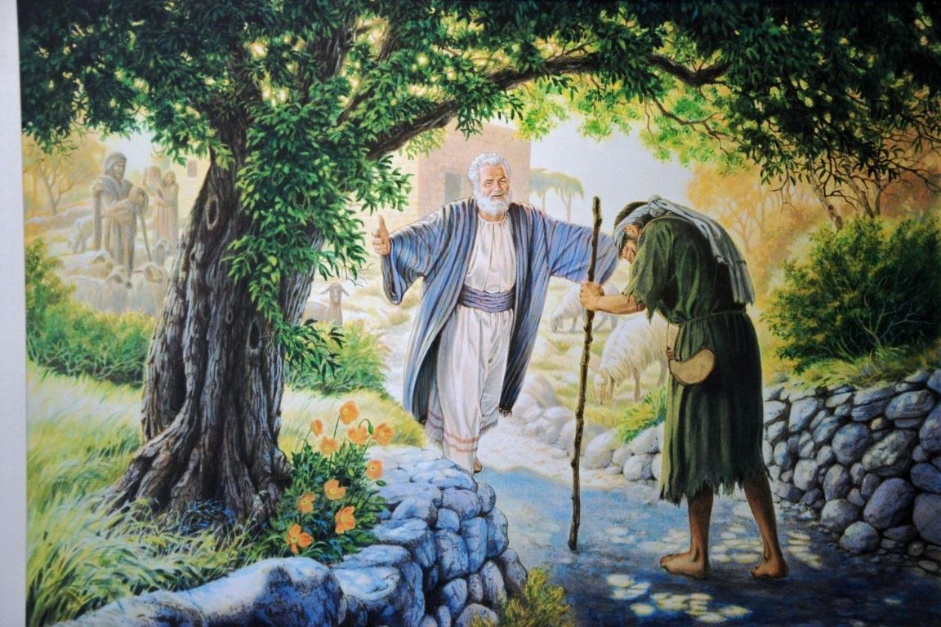
Elements of Repentance

Slide 8
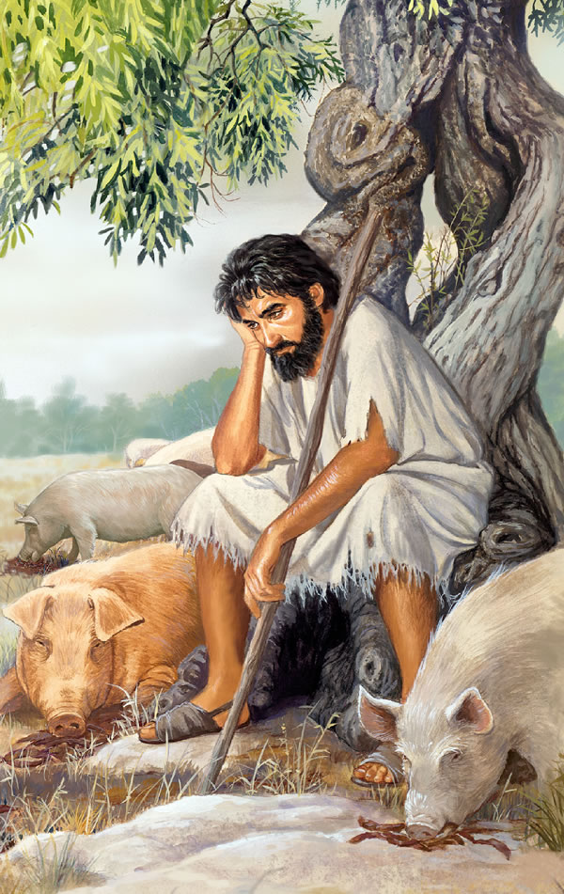
Repentance involves coming to your senses
Most everyone lives their lives in a way that seems right to them
Immaturity, selfishness, and short-sightedness can lead us toward ruin
You clearly see the past, present, and future
Can true repentance start anywhere else?

Slide 9
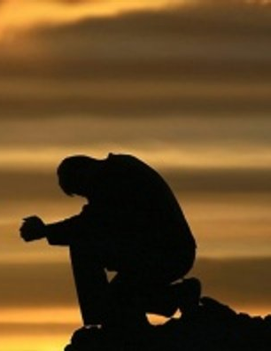
Repentance involves confession
Real repentance doesn’t stop at sorrow
Sadness doesn’t always lead to change (2nd Cor. 7:10)
Repentance continues with confession and commitment
The prodigal son made a decision that things would be different

Slide 10
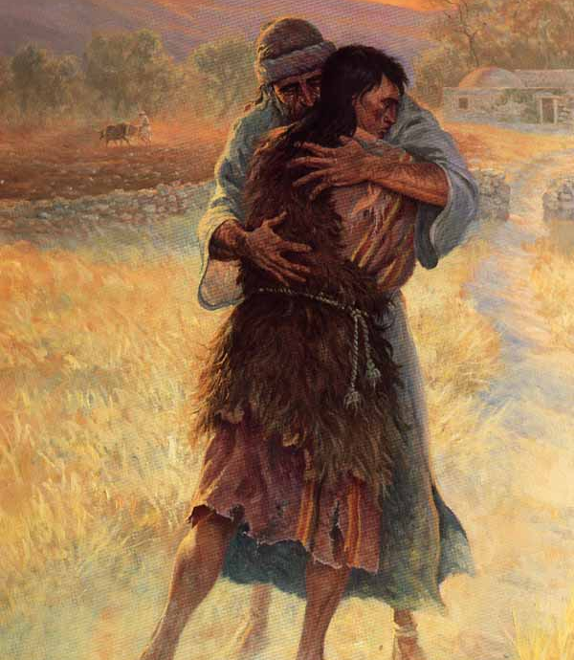
Repentance involves Commitment and Change
The son was ready to be a servant
Repentance concludes with actual change
Luke 3:8-14; Matthew 7:19-21
We will spend a lifetime molding our behavior to be like Jesus

Slide 11
Questions About Repentance
At what point would you say someone has “repented”? (Luke 17:3)
Should we not baptize someone unless they have repented of everything?
Is public repentance necessary? Is it helpful?
Does stumbling in some sin again mean you didn’t repent? How do you know?

